Slide 1
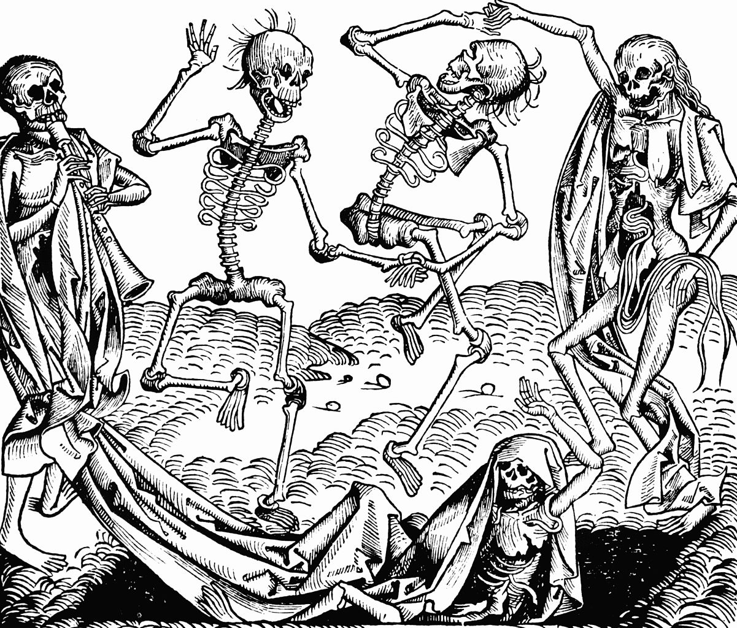
The Black Death

Slide 2
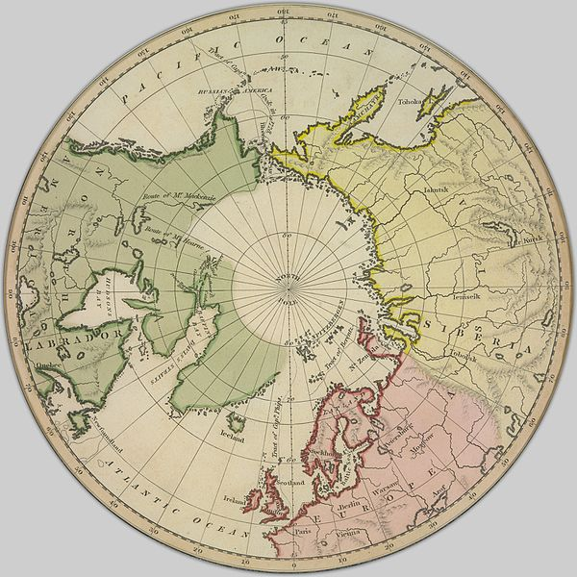
Introduction to the Black Death
The Black Death was a plague that spread from Asia to Europe and Africa in the 14th century.
Also known as the plague and the bubonic plague, the Black Death decimated populations across Eurasia
The Black Death spread rapidly with little to no effective treatment. Once infected, many died within 3-7 days
The Black Death brought widespread terror and confusion to medieval communities. In some cases the sick were locked in their homes or abandoned entirely
The effects of the Black Death were widespread and in some cases changed the social and political structures of nations

Slide 3
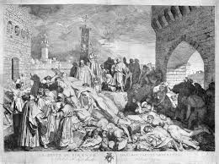
Living conditions in the 14th century
Life in the medieval period was far removed from the lifestyles that we are accustomed to today
Personal hygiene was very poor during this time period, with the majority of people living in dirty, cramped and squalid conditions
Peasants often to had share their home with livestock and were subject to living amongst rats in addition to the filth produced by the animals

Slide 4
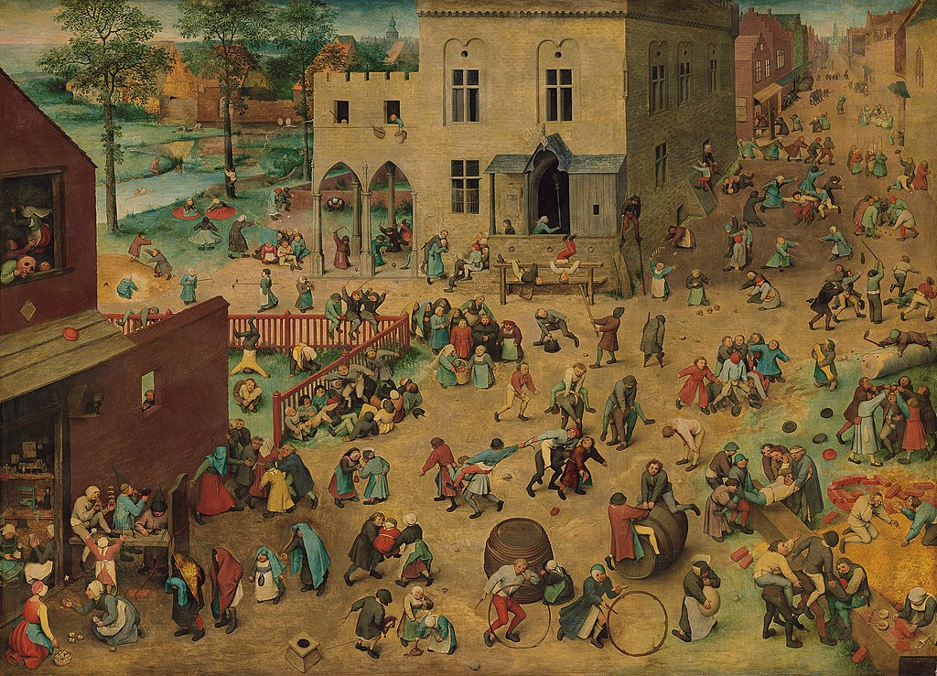
Living conditions in the 14th century
Few knew about the importance of washing and knowledge of dental hygiene had yet to have been established
Life expectancy was very low and there was a high infant mortality rate. Most lived until their 30s-early 40s, this being very much dependant on the social class of the individual

Slide 5
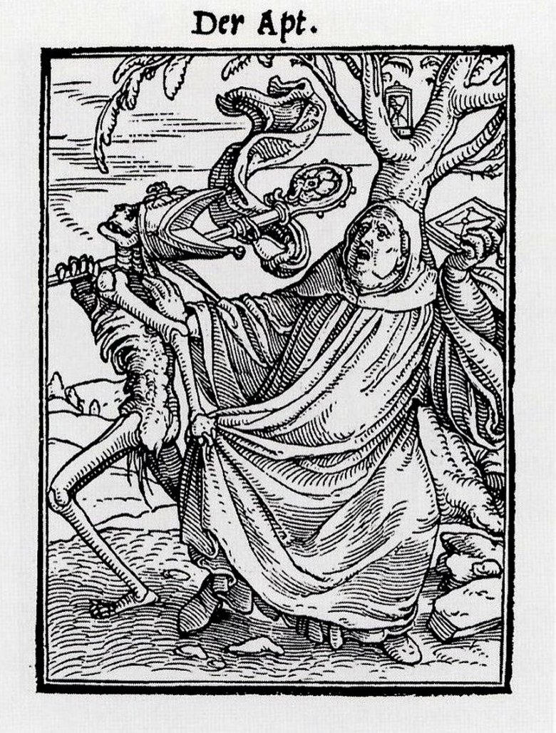
Medical practices and the role of religion
Medical knowledge in this time period was limited. There was little understanding of contagion and/or the manner by which illness spread between humans and animals
Medicine came in the form of traditional herbal remedies that were administered by monks or healer women. Other treatments were based on superstitions and generally had little to no actual benefits.

Slide 6
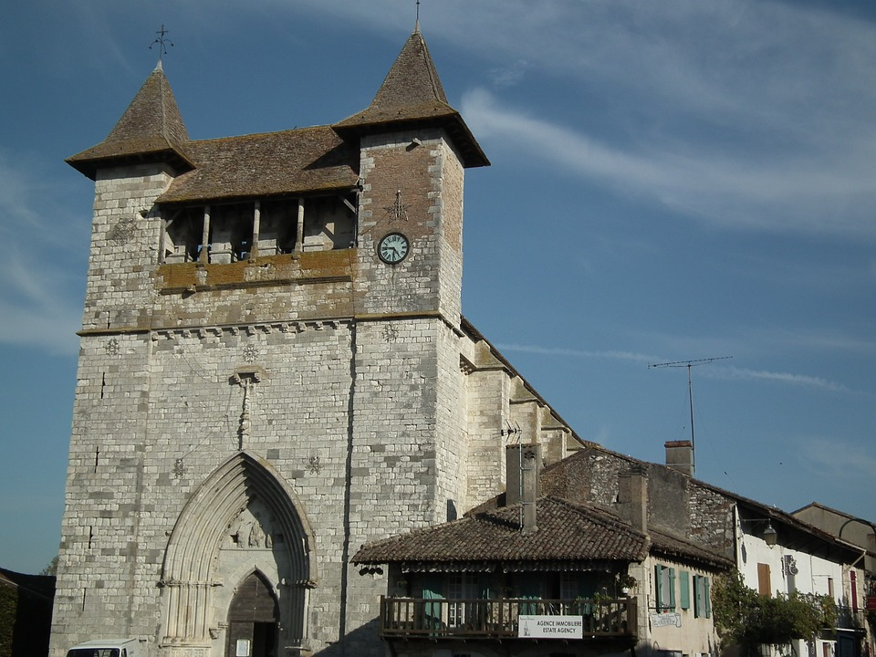
Medical practices and the role of religion
Illness and disease were often attributed to being the work of god, the manner of alleviation being paying penance to God and seeking forgiveness
The Catholic Church actively encouraged the idea that life's misfortunes were due to individuals not behaving in a way that reflected the will of god

Slide 7
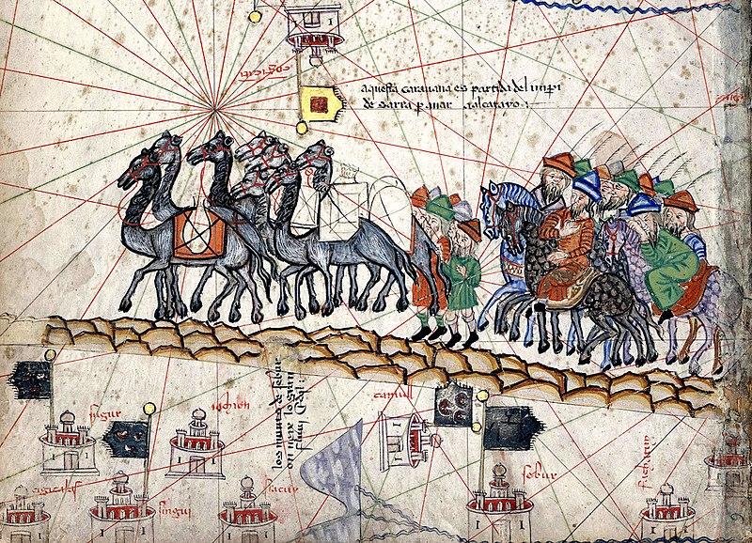
Origins of the Black Death
Historical research has demonstrated that the Black Death had its origins in China
Trade routes enabled to plague to be carried along the silk road, namely by traders and armies

Slide 8
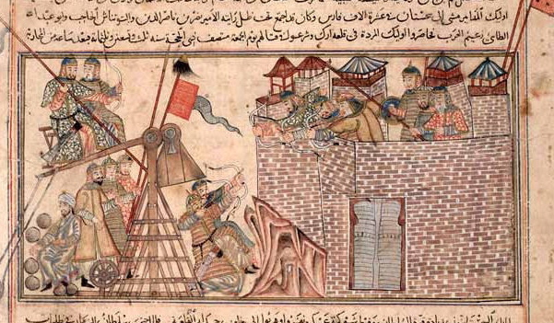
Origins of the Black Death
The Black Death spread to Crimea during a Kipchak invasion. The Kipchak army were dying rapidly as a result of the plague and then resorted to catapulting the bodies of the infected into cities.
Ships left Crimea and spread the plague further westward and into Mediterranean ports, subsequently spreading the plague across continental Europe.
Ships then took the plague further to Africa and Britain.

Slide 9
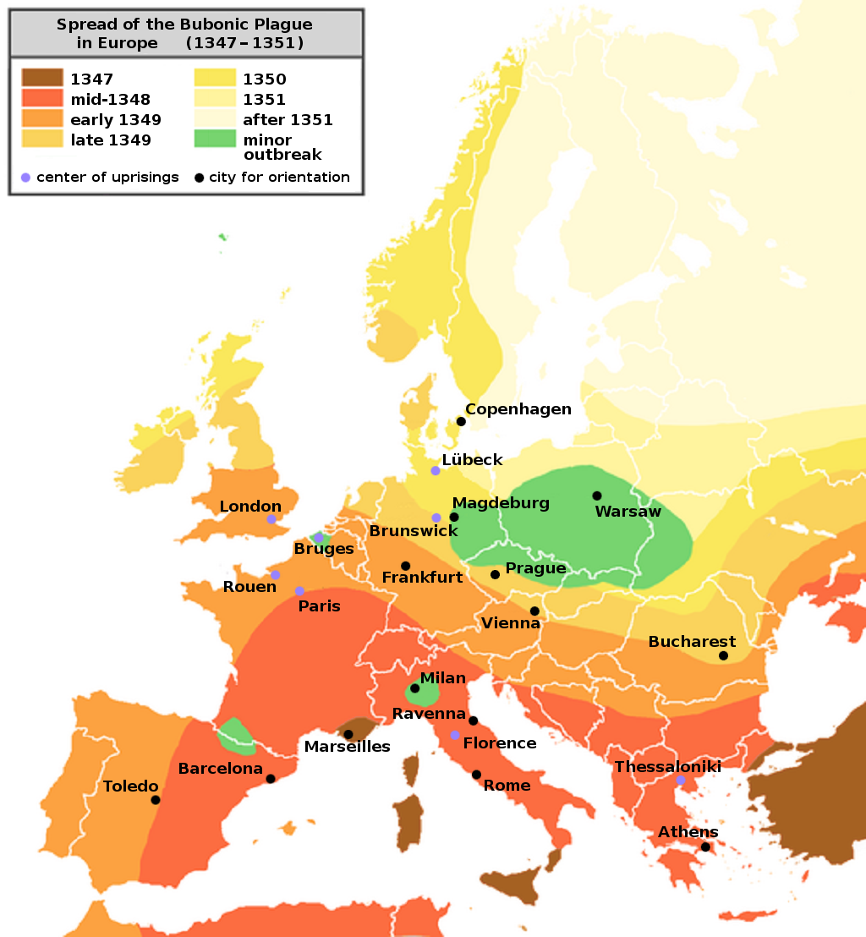
Spread of the Black Death
Original by Roger Zenner (de-WP)Enlarging &amp; readability editing by user Jaybear / CC BY-SA (http://creativecommons.org/licenses/by-sa/3.0/)

Slide 10
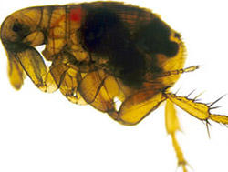
Causes of the Black Death
It is now believed that the Black death is a combination of three types of plague: Bubonic plague, pneumonic plague and septicemic plague
The key cause of the bubonic plague is the Yersinia pestis bacteria that is carried in the stomach of fleas.
The fleas carrying the disease lived on the bodies of rats. Rats were common in medieval society and found in everywhere in the street, homes and buildings.

Slide 11

Causes of the Black Death
When rats died from the plague, the fleas jumped from the rats onto humans to feed and in doing so infected the humans
Human to human infection came through contact with the infected person, either by the inhalation of respiratory droplets (e.g. from coughing, sneezing) or touching infected areas of the body (e.g. directly touching buboes)

Slide 12
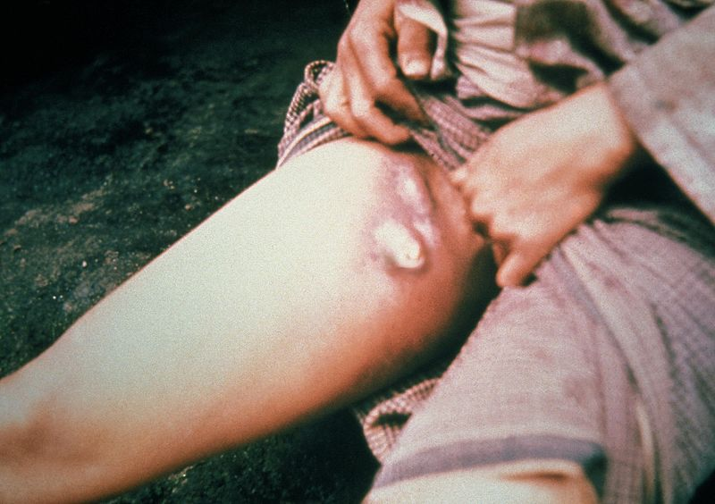
Symptoms of the Black Death
Common symptoms of the Black Death included:
Buboes: large swollen lumps that appeared in the groin and armpits. Buboes often ended up full of blood and pus and were subject to painful rupturing
Headaches
Vomiting
Pain throughout body
High fever
Delirium
Loss of motor skills: e.g. voluntary movements, walking, talking

Slide 13
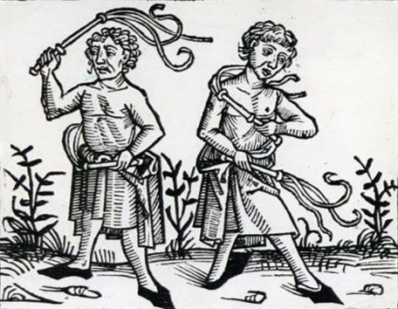
Responses to the Black Death
There were many different responses to the spread of the plague.
A religious group known as the Flagellants whipped themselves as self-punishment and an attempt to obtain forgiveness. They often travelled in between towns participating in the practice in order to cleanse their sins
There was widespread persecution of the Jewish religion, with many blaming the Jews for the plague, claiming that they had poisoned the drinking water in wells.
Across Europe thousands of Jewish people were slaughtered in response to the plague and pre-existing prejudice held in communities.

Slide 14
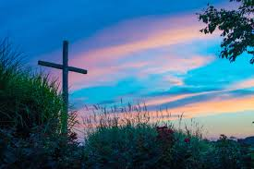
Responses to the Black Death
For many, the plague created doubt in the role of the church and it’s practitioners. Many saw the death of monks and priests as an indication that God was unhappy with their actions, and subsequently moved away from their religious beliefs.
Others took the opportunity to move away from religion and revel in practices previously admonished, whilst some moved further towards piety in an attempt to redeem themselves and society in the eyes of God.
Most importantly, dissention towards the church led to further research and investigation of medical practices. Many doctors started performing autopsies to learn more about the function of the human bodies and expanded on their clinical practices.

Slide 15
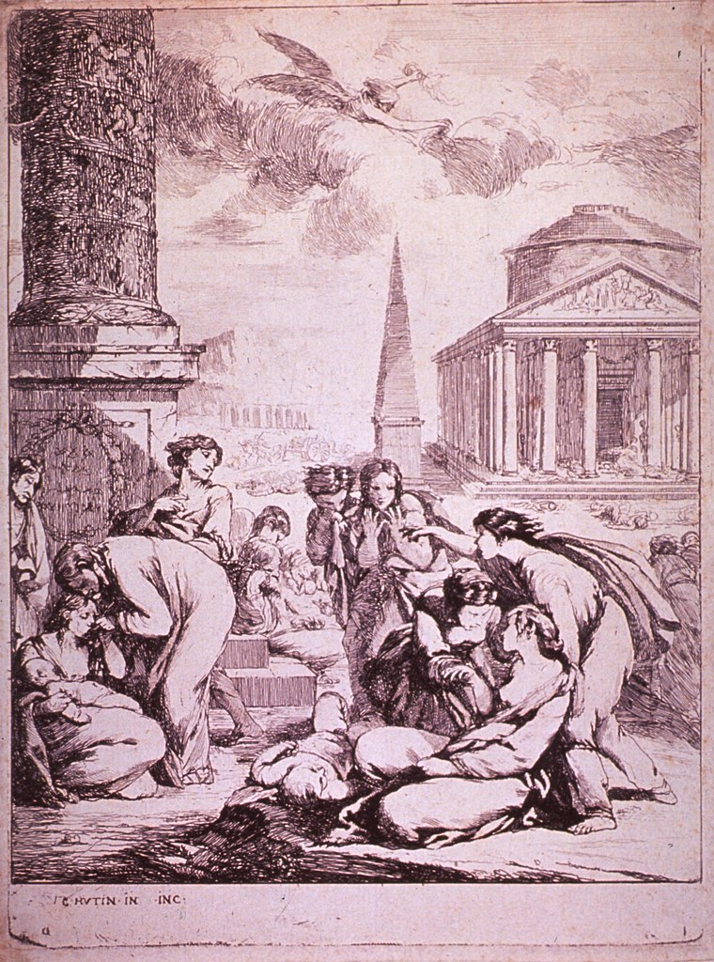
Short-term effects of the Black Death
The Black Death resulted in large scale depopulation across Eurasia and Africa
The reliability of data on the number of deaths as a result of the plague has been questioned in many instances, leading to the number of deaths often being approximated.
The best available data suggests that in Europe between 33-40% of population died as a result of the plague, in addition to around 33% of the population in the Middle East, 40% of the Egyptian population and 35 million people in China

Slide 16
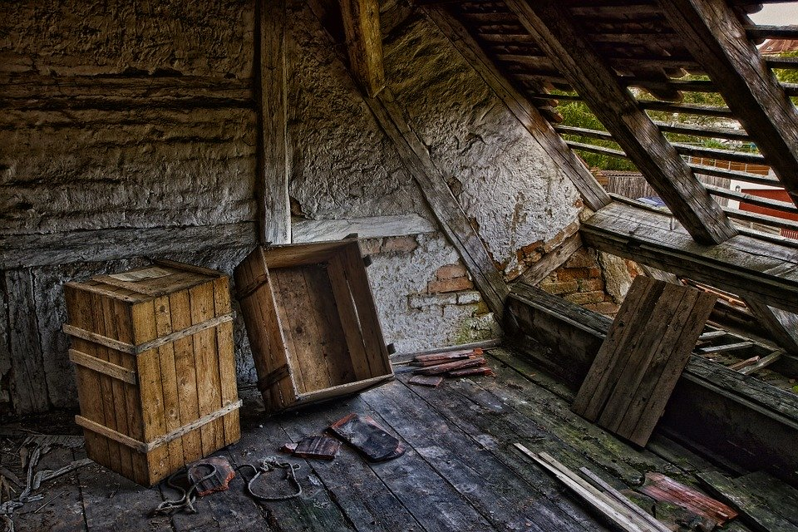
Short-term effects of the Black Death
Towns suffered as a result of the widespread deaths. With decimated populations, filth and corpses began to pile up in the streets
Buildings weren’t maintained and crops suffered in the fields, this leading to subsequent food shortages
In some cases villages and towns were left completely abandoned

Slide 17
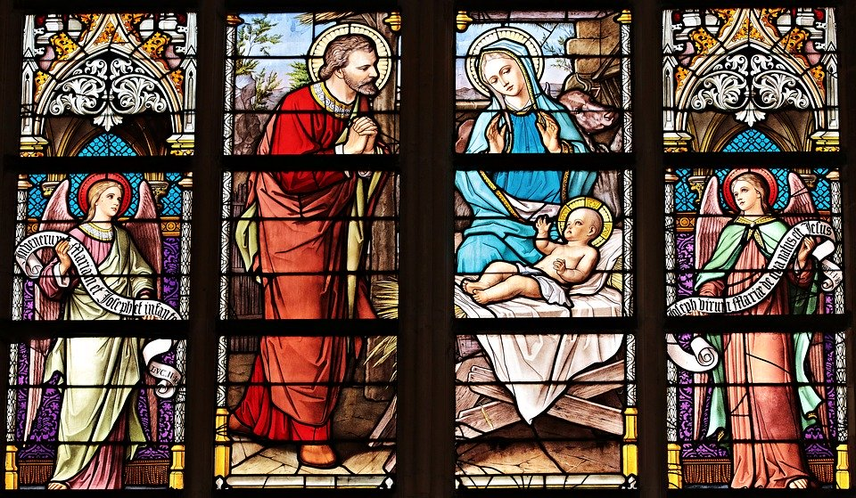
Long-term effects of the Black Death
The Black Death led to a weakening of the feudal system; due to large scale depopulation there became opportunities for individuals to take on new roles and responsibilities within society
This led to the breaking down of previously rigid social structures
The Black Death also weakened position of the church. There was anger towards the perceived inaction of God in response to the plague. The teachings of the Church were increasingly dismissed as following these teachings did not lead to people being spared from the plague.

Slide 18
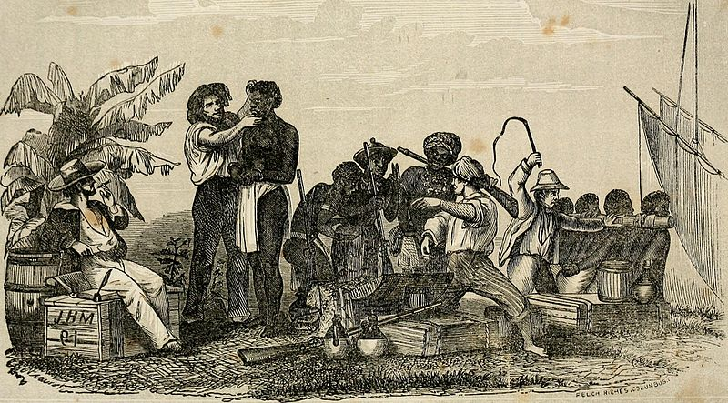
Long-term effects of the Black Death
Those who survived, and had wealth, started to invest in art and culture, meaning that there was increased demand for these items. It is believed that this led to the early beginnings of the Renaissance age.
With areas so severely depopulated there was a dire lack of a suitable labour force. This sparked the beginning of the slave trade, with the Portuguese and Spanish bringing slaves from Africa to Europe in 15th century.

